Slide 1


Zemelak Goraga
4/28/2023

Slide 2
Outline
Executive Summary
Introduction
Methodology
Results
Conclusion
Appendix

Slide 3
Executive Summary
Summary of methodologies
Data Collection – API & Web Scraping
Data Wrangling
Exploratory Data Analysis – SQL & Data Visualization
Interactive Visual Analytics - Folium
Machine Learning Prediction
Summary of all results
Exploratory Data Analysis
Interactive analytics
Predictive Analytics

Slide 4
Introduction
Project background and context
This project focused on a rocket launch case of Space X. It advertises Falcon 9 rocket launches on its website with a cost of 62 million dollars; other providers cost upward of 165 million dollars each, much of the savings is because Space X can reuse the first stage. Therefore, if we can determine if the first stage will land, we can determine the cost of a launch. This information can be used if an alternate company wants to bid against space X for a rocket launch.
Problems you want to find answers
In this capstone, we will predict if the Falcon 9 first stage will land successfully?
What factors determine if the rocket will land successfully?
The interaction amongst various features
What operating conditions needs to be in place for successful landing

Slide 5

Section 1

Slide 6
Methodology
Executive Summary
Data collection methodology:
Data collection Method
- SpaceX API and web scraping from Wikipedia was applied for data collection
Perform data wrangling
- One-hot encoding was applied to categorical features
Perform exploratory data analysis (EDA) using visualization and SQL
Perform interactive visual analytics using Folium and Plotly Dash
Perform predictive analysis using classification models
How to build, tune, evaluate classification models

Slide 7
Data Collection
The data was collected using various methods:
Data was first collected using SpaceX API by making a get request
In the Next step, the response content was decoded as a Json using .json() function call and turned it into a pandas dataframe using .json_normalize().
Then the data was cleaned, checked for missing values and fill in missing values
Also performed web scraping to collect Falcon 9 historical launch records from a Wikipedia page

Slide 8
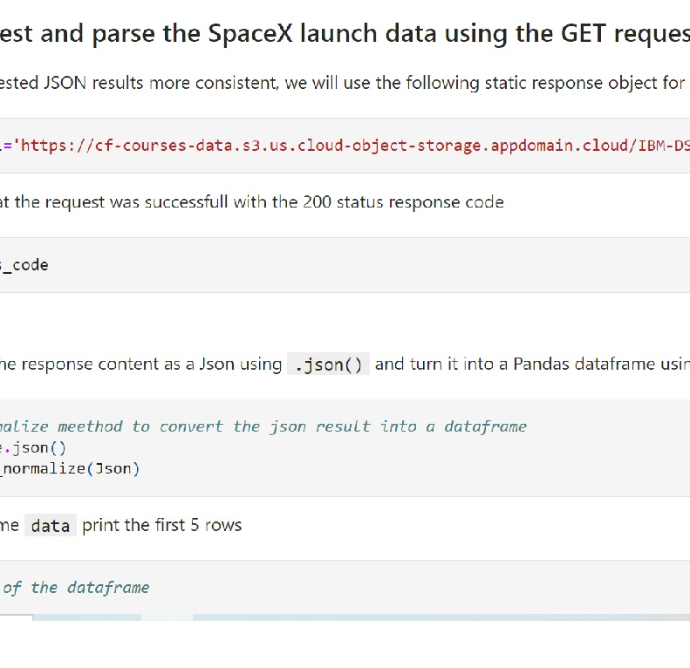
Data Collection – SpaceX API
The get request was applied to the SpaceX API to collect data, clean it and did data wrangling and formatting.
The link to the notebook is:
https://github.com/ZemelakGoraga/IBM_Data_Science/blob/main/Complete%20the%20Data%20Collection%20API-Space%20X%20Falcon%209%20rocket%20launche.ipynb

Slide 9
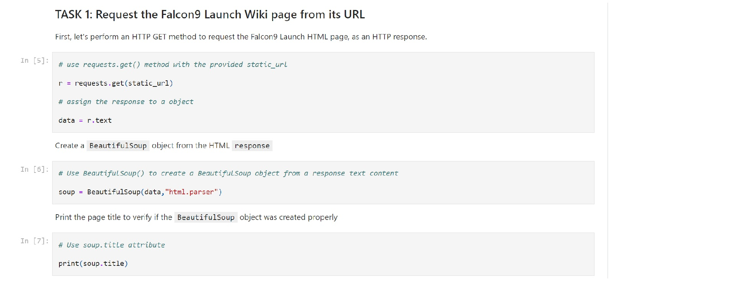
Data Collection - Scraping
Web scraping was applied to collect Falcon 9 historical launch records from a Wikipedia using BeautifulSoup and request, to extract the Falcon 9 launch records from HTML table of the Wikipedia page
Then created a data frame by parsing the launch HTML
The link to the notebook is:
https://github.com/ZemelakGoraga/IBM_Data_Science/blob/main/Complete%20the%20Data%20Collection%20with%20Web%20Scraping-Space%20X%20Falcon%209%20rocket%20launche.ipynb

Slide 10
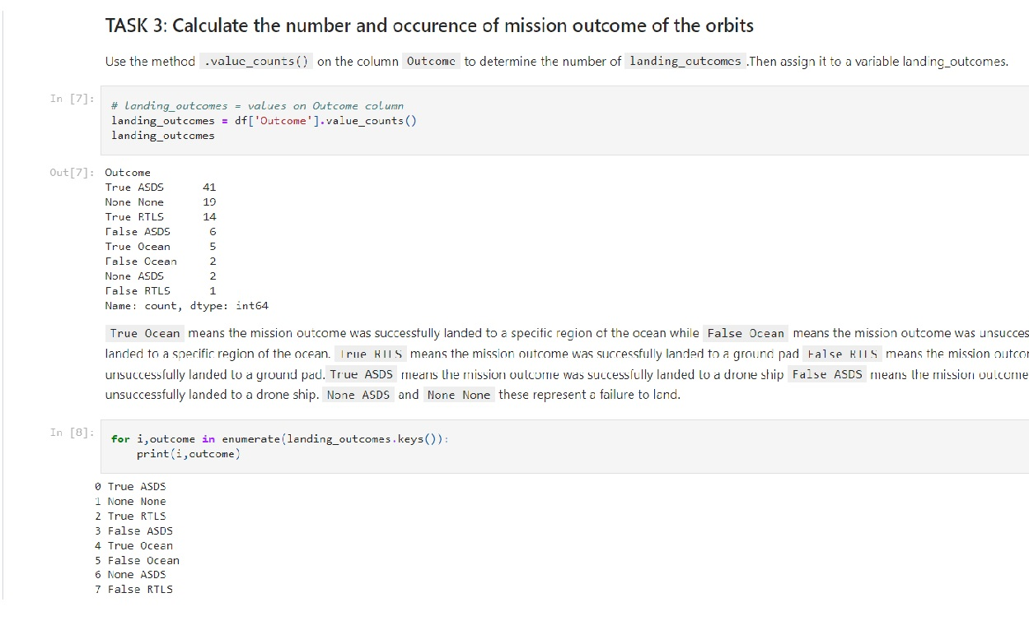
Data Wrangling
Data was filtered using the BoosterVersion column to only keep the Falcon 9 launches, then dealt with the missing data values in the LandingPad and PayloadMass columns.
For the PayloadMass , missing data values were replaced using mean value of column.
Exploratory data analysis was performed and training labels were determined.
The number of launches at each site were calculated , and the number and occurrence of each orbits too.
The link to the notebook is
https://github.com/ZemelakGoraga/IBM_Data_Science/blob/main/Data%20wrangling-Space%20X%20Falcon%209%20rocket%20launche.ipynb

Slide 11
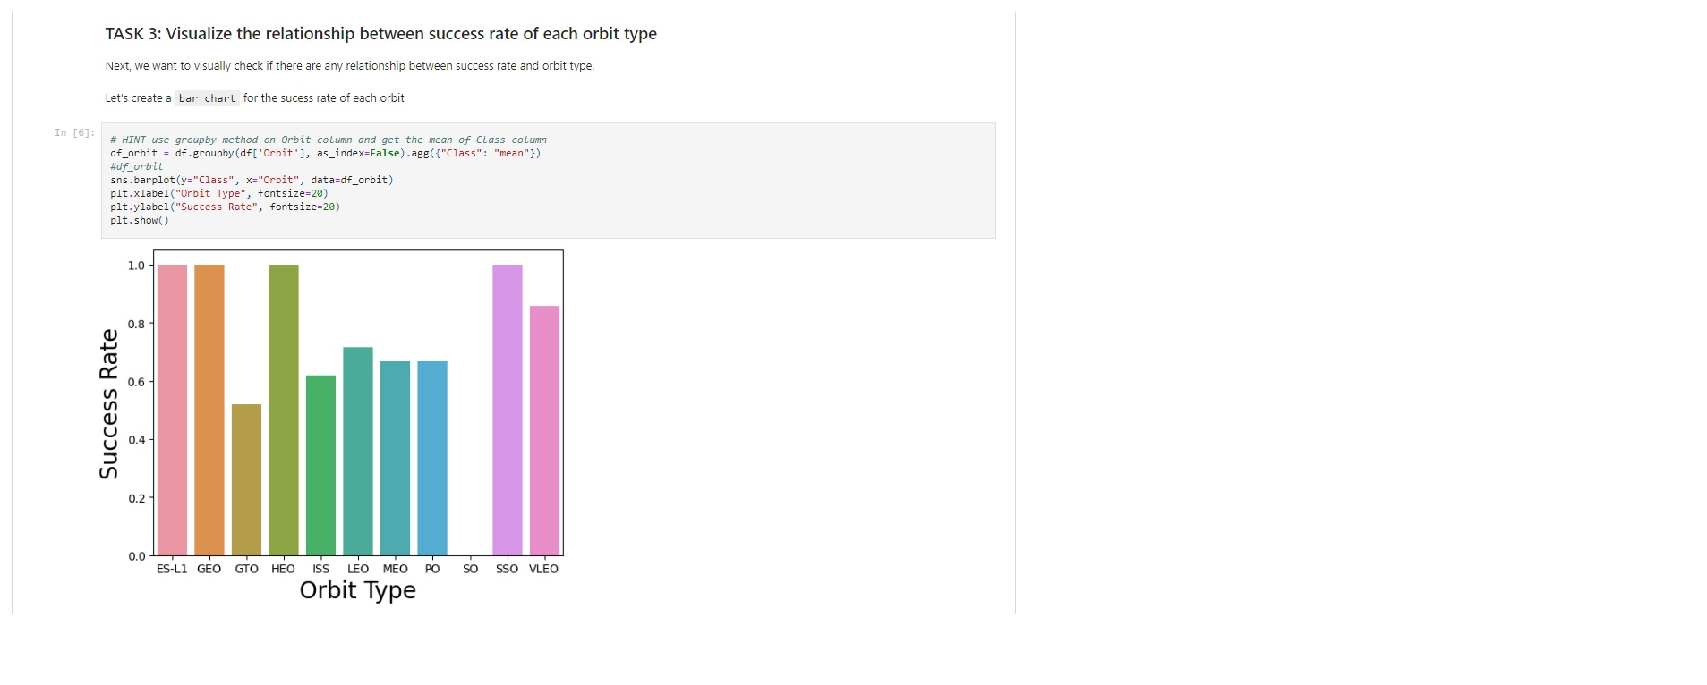
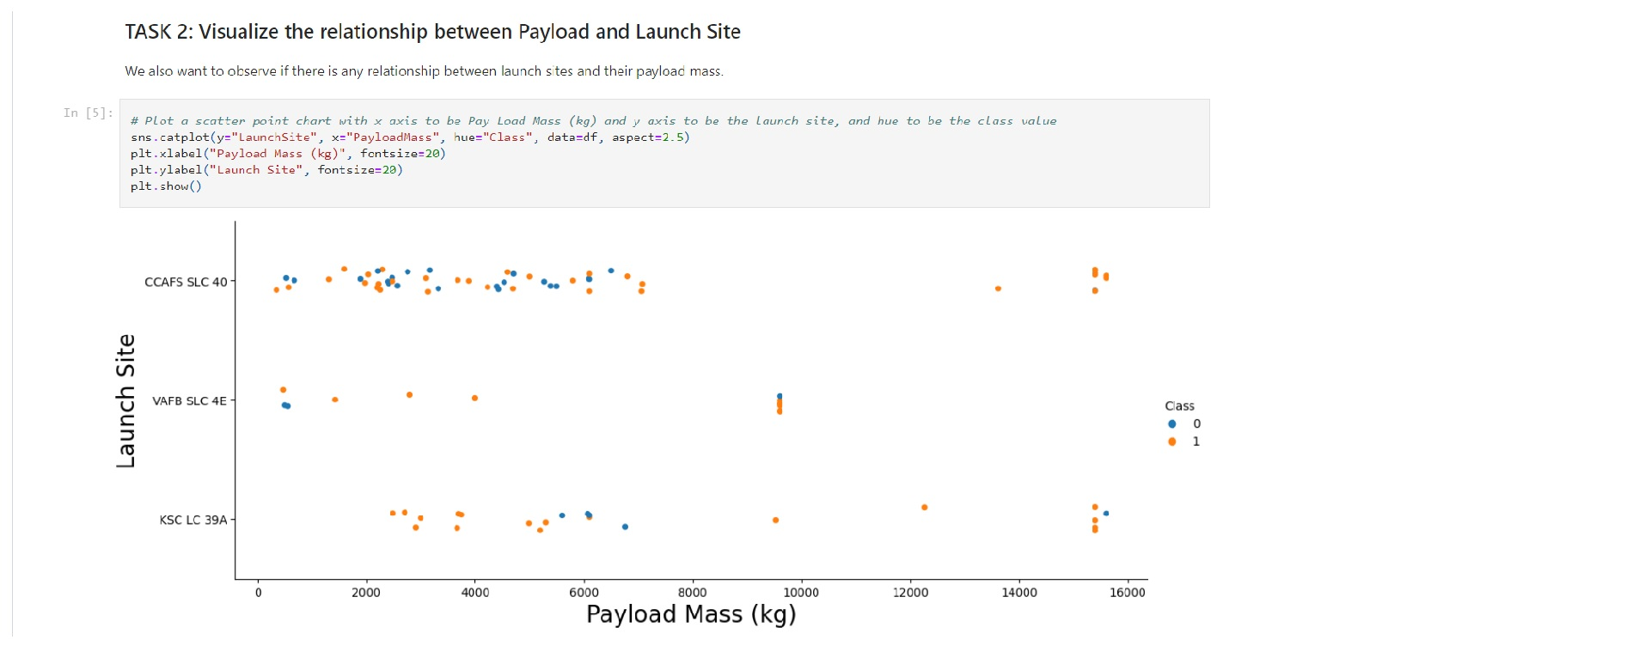
EDA with Data Visualization
Exploratory data analysis was performed by visualizing the relationship between flight number and launch Site, payload and launch site, success rate of each orbit type, flight number and orbit type, the launch success yearly trend.
Scatter plots was used to Visualize the relationship between Flight Number and Launch Site, Payload and Launch Site, FlightNumber and Orbit type, Payload and Orbit type.
Bar chart was used to Visualize the relationship between success rate of each orbit type; Whereas, Line plot was used to Visualize the launch success yearly trend.
The link to the notebook is:
https://github.com/ZemelakGoraga/IBM_Data_Science/blob/main/EDA%20with%20Data%20Visualization-Space%20X%20Falcon%209%20rocket%20launche.ipynb

Slide 12
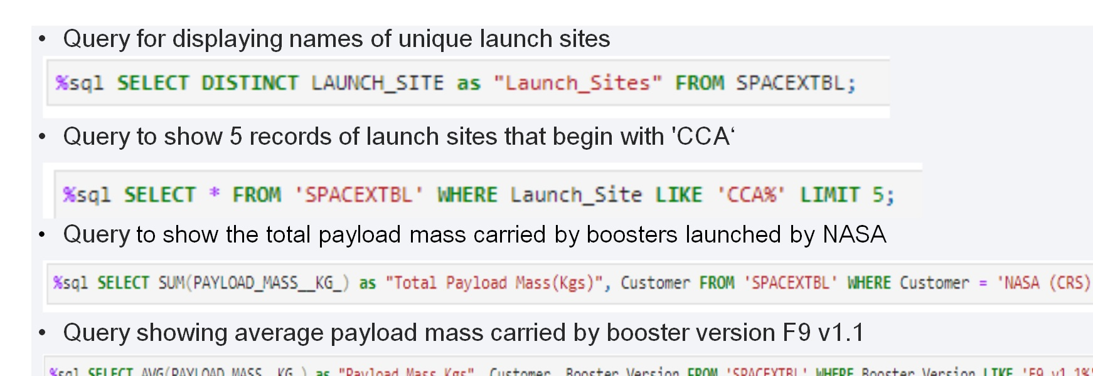
EDA with SQL
SQL queries were performed for EDA in order to find answer for the names of unique launch sites, the total payload mass carried by boosters launched by NASA (CRS), the average payload mass carried by booster version F9 v1.1, and the total number of successful and failure mission outcomes .
The link to the notebook is
https://github.com/ZemelakGoraga/IBM_Data_Science/blob/main/Execute%20sql%20queries-Space%20X%20Falcon%209%20rocket%20launche.ipynb

Slide 13
Folium map was created to marked all the launch sites
Map objects such as markers, circles, and lines were created to mark the success or failure of launches for each launch site.
Feature launch outcomes (failure or success) were assigned to class 0 and 1, where 0 for failure, and 1 for success.
which launch sites have relatively high success rate was identified using the color-labeled marker clusters
The distances between a launch site to its proximities were calculated.
Here is the GitHub URL of the map:
https://github.com/ZemelakGoraga/IBM_Data_Science/blob/main/Interactive%20visual%20analytics%20using%20Folium-Space%20X%20Falcon%209%20rocket%20launche.ipynb
Build an Interactive Map with Folium

Slide 14
An interactive dashboard application with Plotly dash was built by adding a Launch Site Drop-down Input Component, adding a callback function , adding a Range Slider and adding a callback function
Pie charts and Scatter graph were plotted for showing the total launches by a certain sites and the relationship with Outcome and Payload Mass (Kg) for the different booster version, respectively.
The link to the notebook is:
https://github.com/ZemelakGoraga/IBM_Data_Science/blob/main/Interactive%20Dashboard-Space%20X%20Falcon%209%20rocket%20launche
Build a Dashboard with Plotly Dash

Slide 15
First the data was loaded as a Pandas Datafram using numpy and pandas
Next, the data was transformed and splited into training and testing.
Afterwards, different machine learning models were built
We used accuracy as the metric for our model,
Finally, the models was improved using feature engineering and algorithm tuning and the best model was identified.
The link to the notebook is:
https://github.com/ZemelakGoraga/IBM_Data_Science/blob/main/Predictive%20Analysis-SpaceX-Predictive%20Analysis-Space%20X%20Falcon%209%20rocket%20launche.ipynb
Predictive Analysis (Classification)

Slide 16
Results
Exploratory data analysis results
Interactive analytics demo in screenshots
Predictive analysis results

Slide 17

Section 2

Slide 18
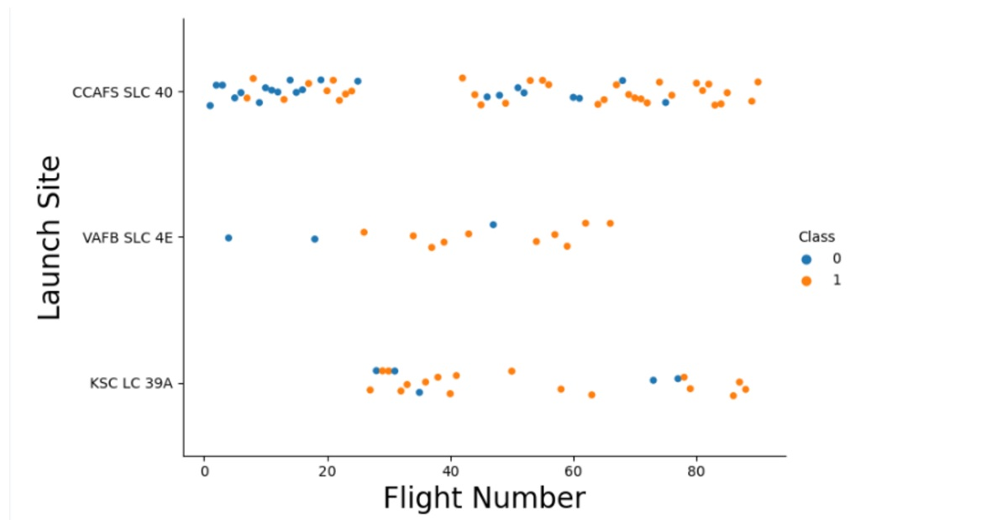
Flight Number vs. Launch Site
Insight: the success rate increased as number of flights increased

Slide 19
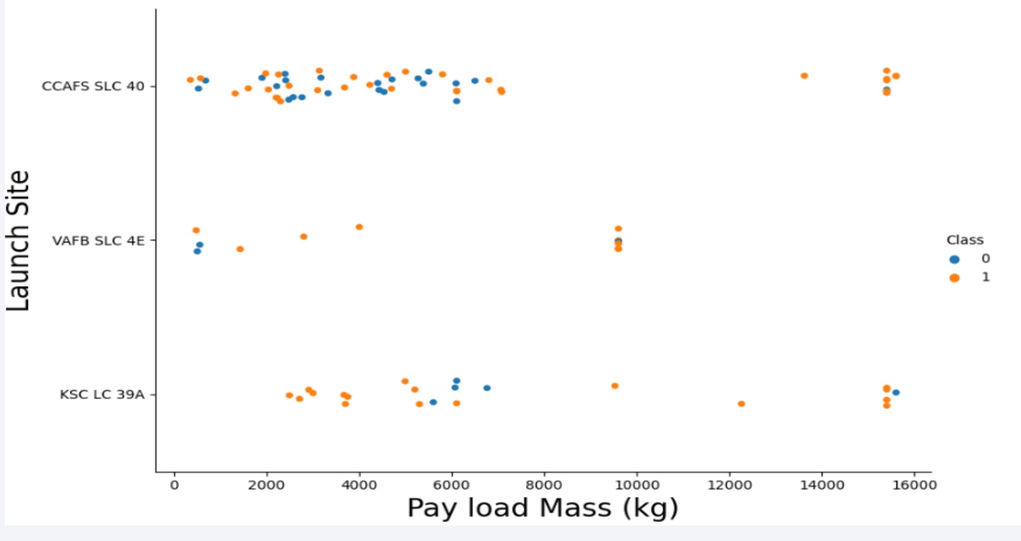
Payload vs. Launch Site
Insight: As the payload mass increased, the success rate also increased

Slide 20
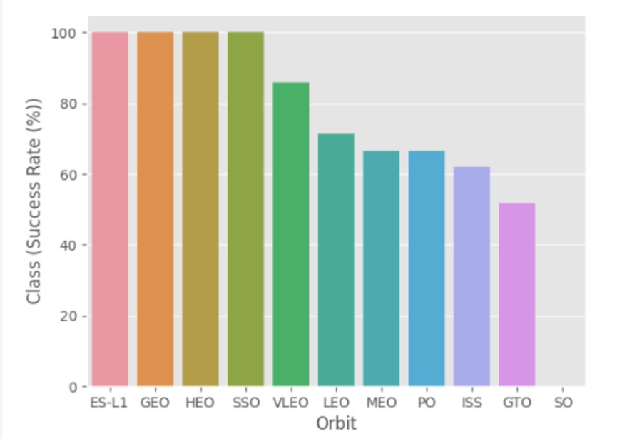
Success Rate vs. Orbit Type
As can be seen from the chart, orbit ES-L1, GEO, HEO, and SSO had the highest success rate.

Slide 21
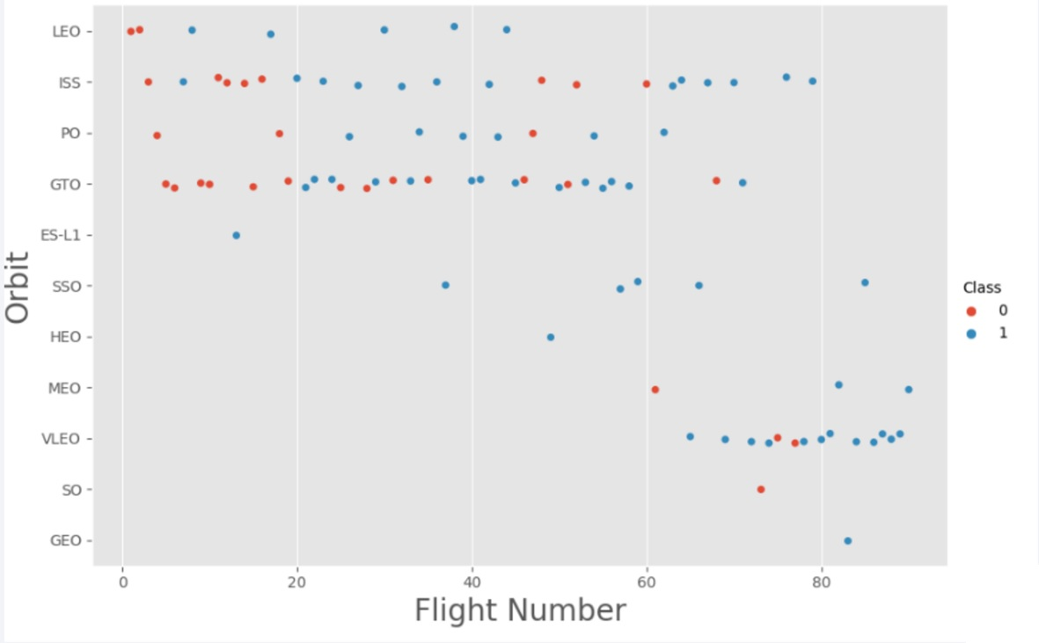
Flight Number vs. Orbit Type
As can be seen from the plot, the more the number of flights(Flight Number) at Orbit LEO, ISS, ES-L1, and VLEO, there is frequent success. This might imply positive relationship between target and independent variables at those Orbits.

Slide 22
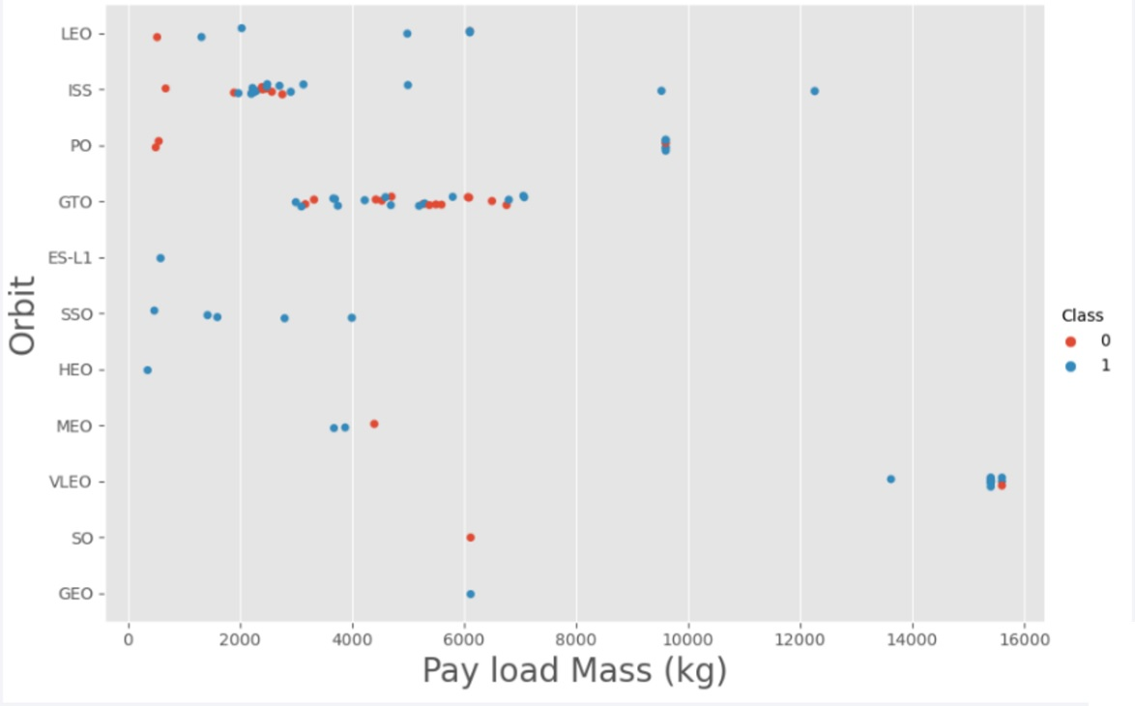
Payload vs. Orbit Type
As can be seen from the plot, the more the pay load mass, there is most frequent success. This is true for PO, LEO and ISS Orbits. So, it seems that there is a positive r/ship between target and independent variables at those three Orbits.

Slide 23
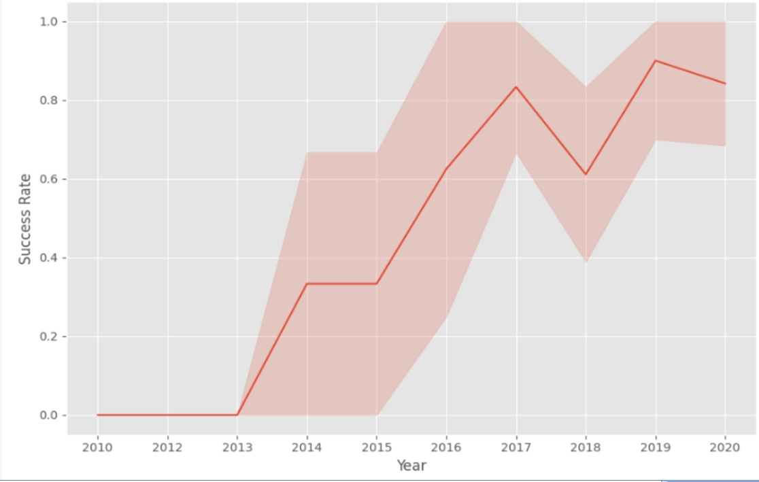
Launch Success Yearly Trend
The plot shows an increasing success rate from the year 2013 on wards. The highest success rate was observed in the year 2019.

Slide 24
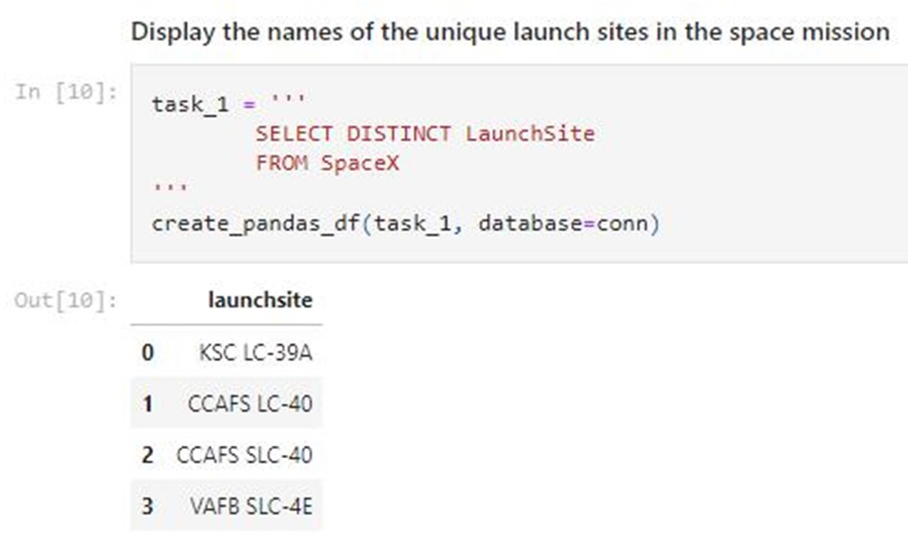
All Launch Site Names
The unique launch sites from the SpaceX data were screened using the ‘SELECT DISTINCT’ statement.
The slide on the left shows the those unique sites.

Slide 25
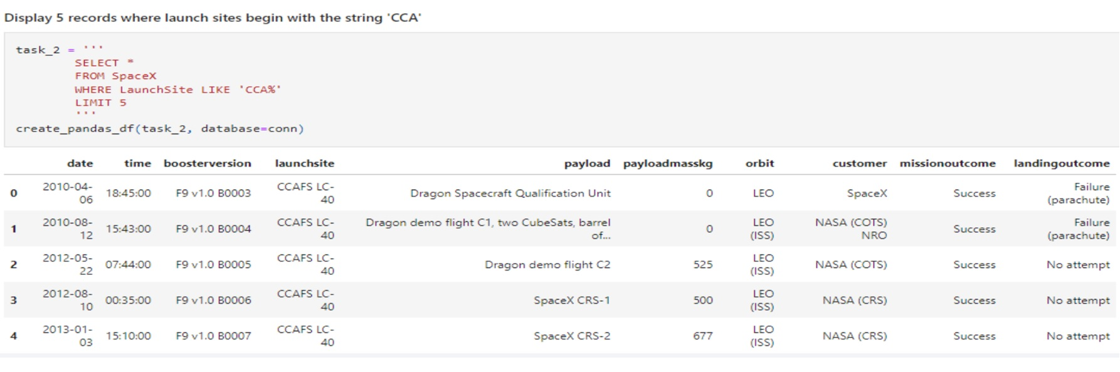
Launch Site Names Begin with 'CCA'
As can be seen below, the query ‘LIKE’ command with ‘%’ wildcard in ‘WHERE’ , was used to display 5 records where launch site names start with `CCA`

Slide 26
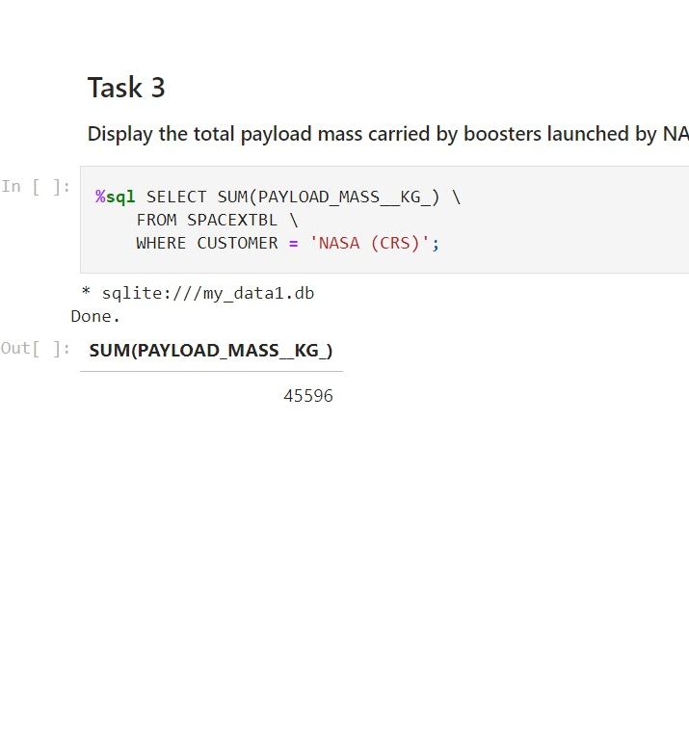
Total Payload Mass
As can be seen the left slide, total payload carried by boosters from NASA was calculated using the ‘SUM()’ function and the result was 45596

Slide 27
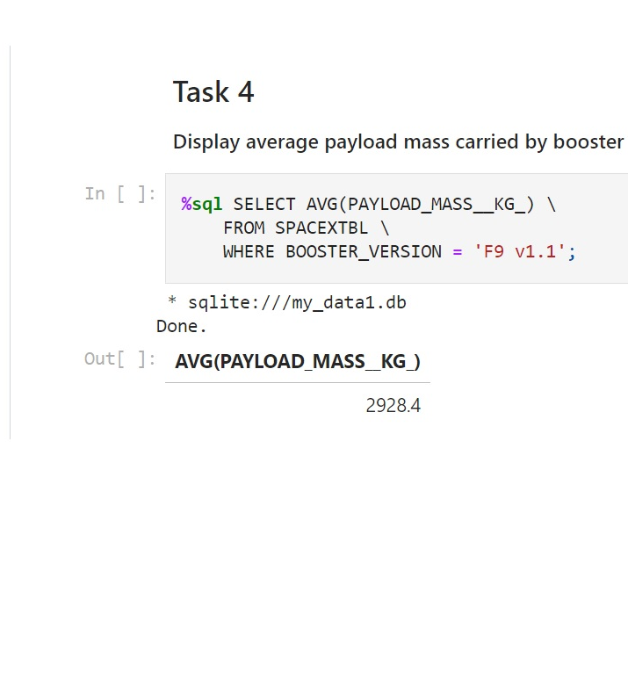
Average Payload Mass by F9 v1.1
Using the AVE() function , the average payload mass carried by booster version F9 v1.1 was 2928.4

Slide 28
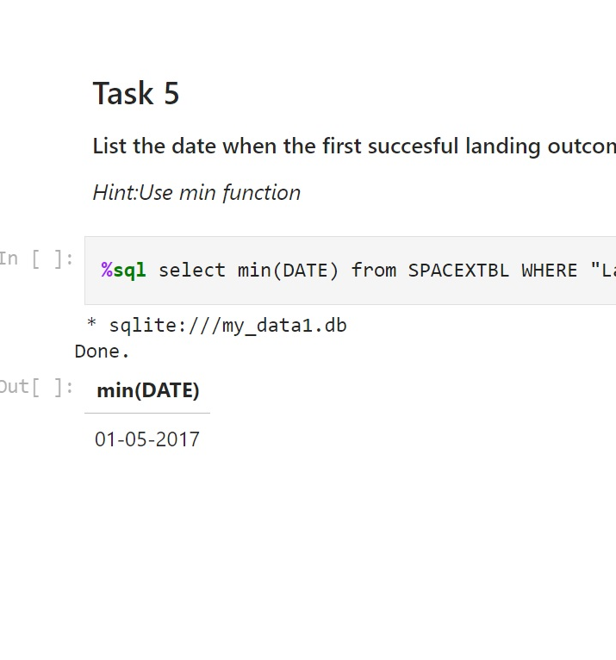
First Successful Ground Landing Date
The ‘MIN()’ function was used to determine the date on which the first successful landing outcome was attained.

Slide 29
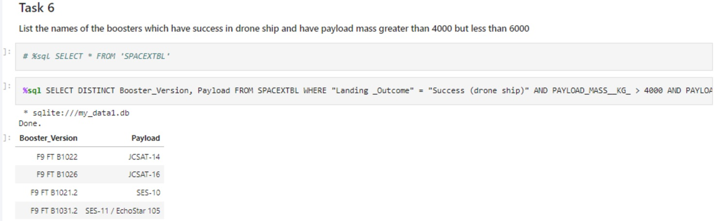
Successful Drone Ship Landing with Payload between 4000 and 6000
The names of the boosters which had success are mentioned below. The WHERE clause was used to filter them.

Slide 30
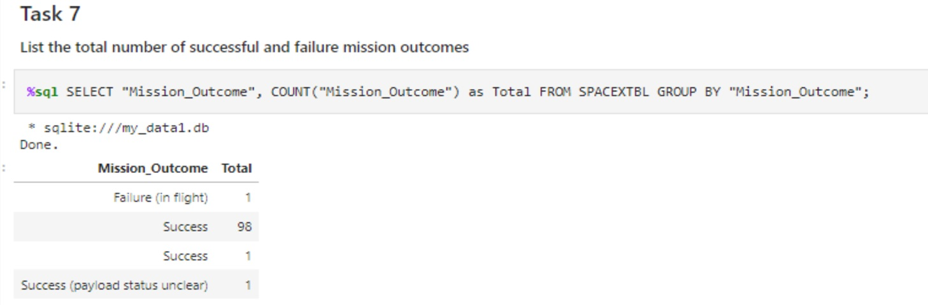
Total Number of Successful and Failure Mission Outcomes
The total number of successful and failure mission outcomes were calculated using the ‘COUNT()’ together with the ‘GROUP BY’ statement

Slide 31
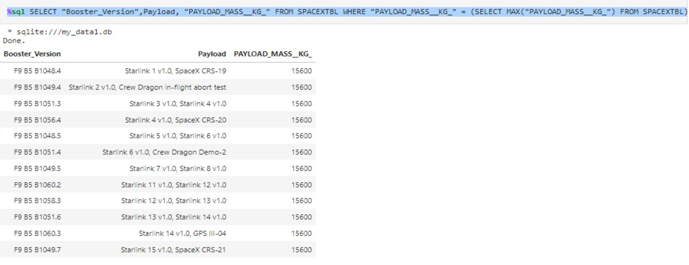
Boosters Carried Maximum Payload
The list of all the boosters that have carried the Max payload of
15600kgs were obtained by using a subquery in the WHERE clause

Slide 32
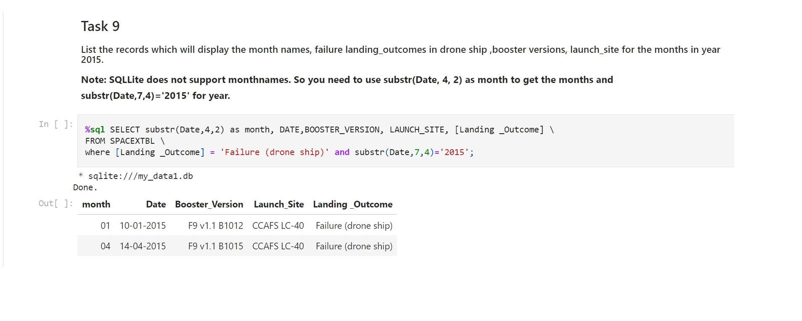
2015 Launch Records
The failed landing outcomes in drone ship, their booster versions, and launch site names for year 2015 were obtained using a combinations of the WHERE clause, LIKE, AND, and BETWEEN conditions

Slide 33
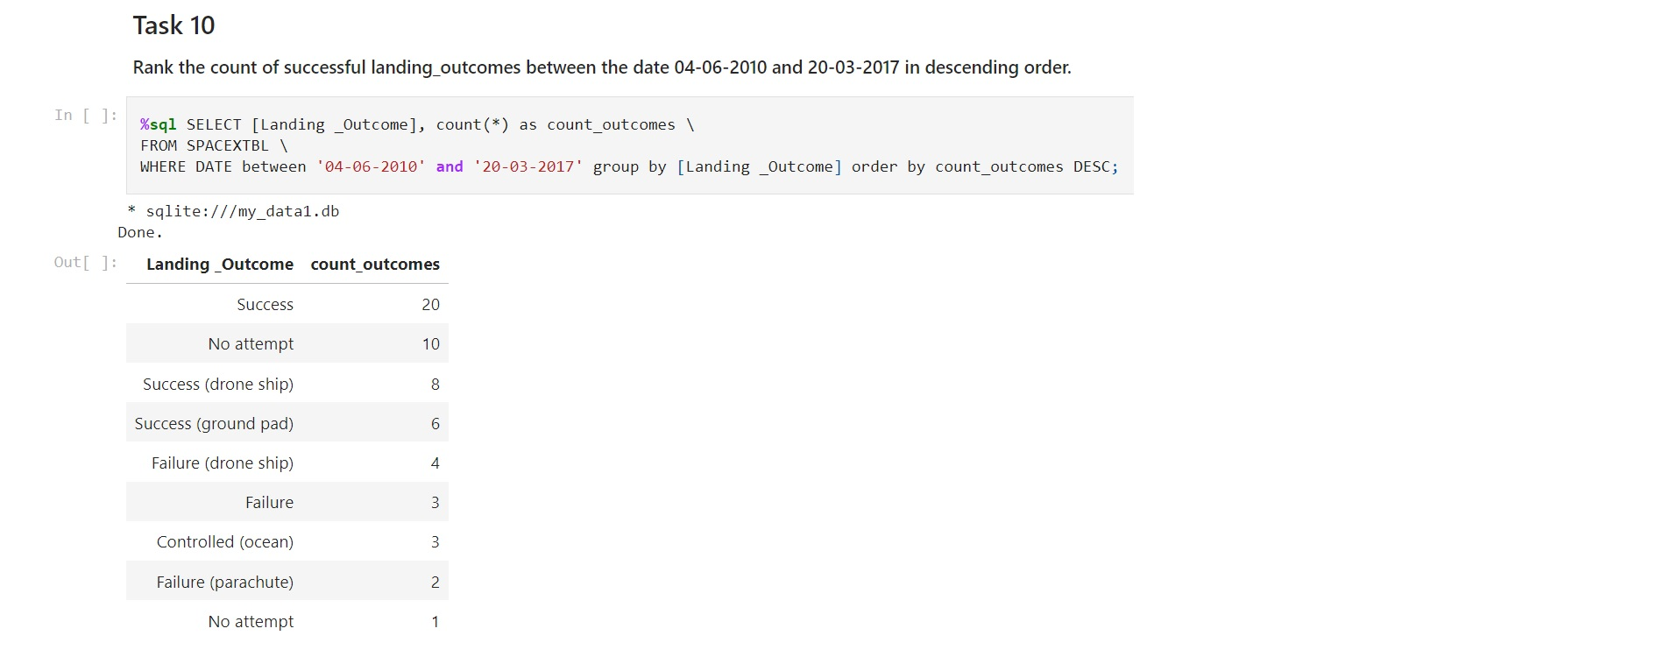
Rank Landing Outcomes Between 2010-06-04 and 2017-03-20
The landing outcomes BETWEEN 2010-06-04 to 2010-03-20 were filtered using
COUNT and WHERE clauses followed by the GROUP BY and the ORDER BY clauses

Slide 34

Section 3

Slide 35
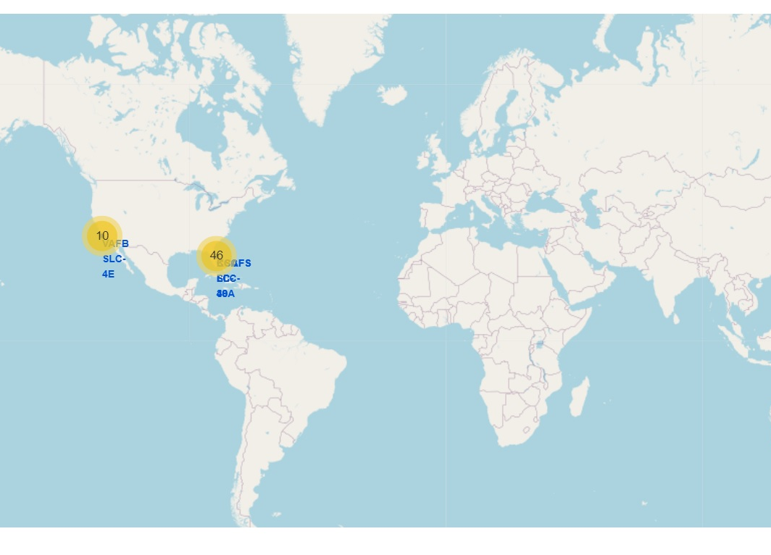
All launch sites global map markers
The launch sites were in close proximity and located close to the Equator

Slide 36
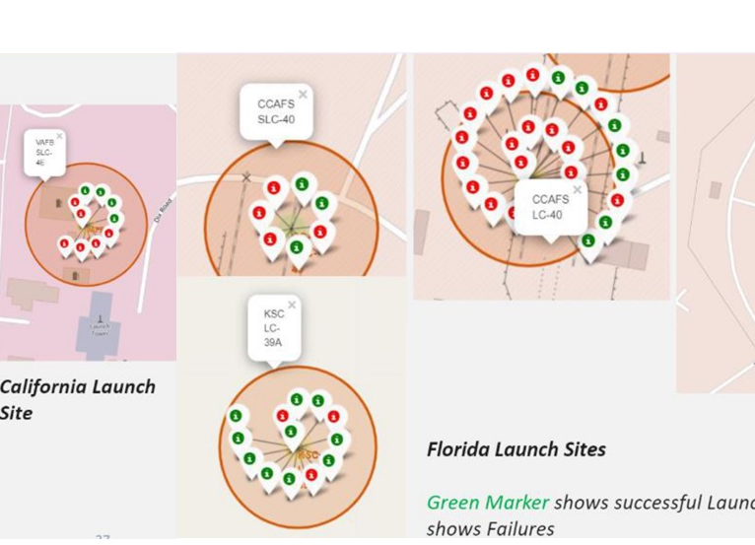
Markers showing launch sites with color labels
Launch site KSC LC-39A has relatively high success rates as compared with all other sites

Slide 37
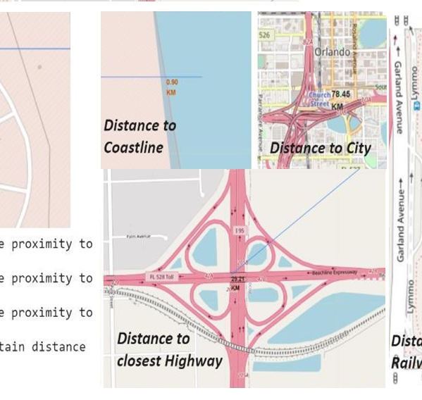
Launch Site distance to landmarks

Slide 38

Section 4

Slide 39
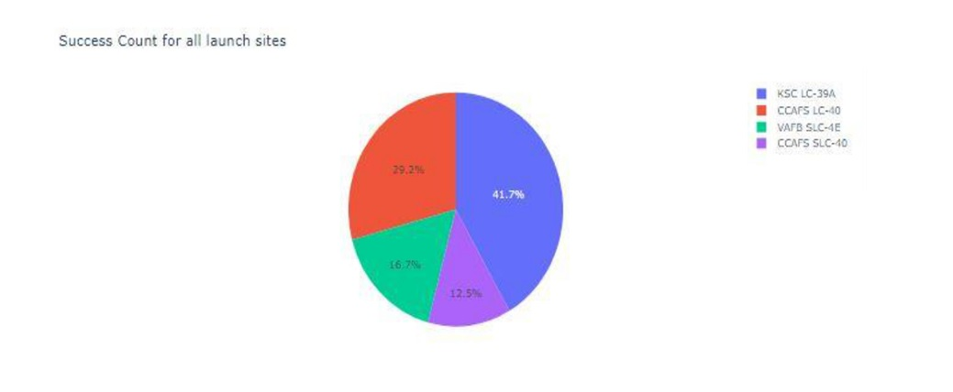
Pie chart showing the success percentage achieved by each launch site
Among all the launch sites, the highest launch success rate (42% ) was achieved by Launch site KSC LC-39, followed by CCAFS LC-40 (29%)

Slide 40
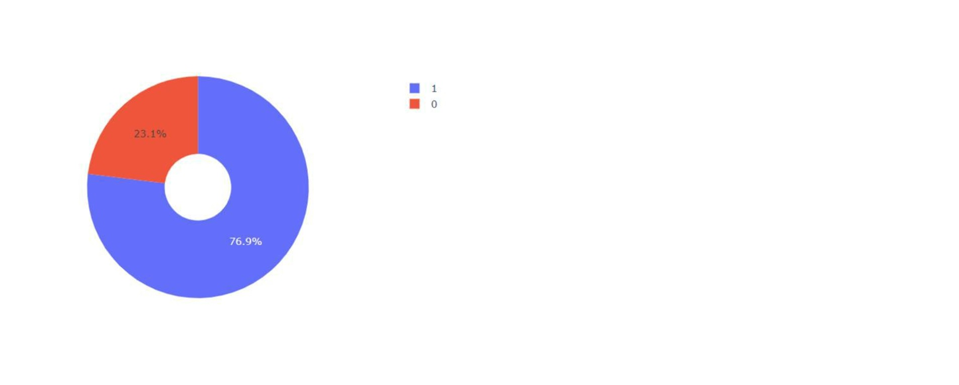
Pie chart showing the Launch site with the highest launch success ratio
Launch site CCAFS LC-40 had the success ratio of 76.9%

Slide 41
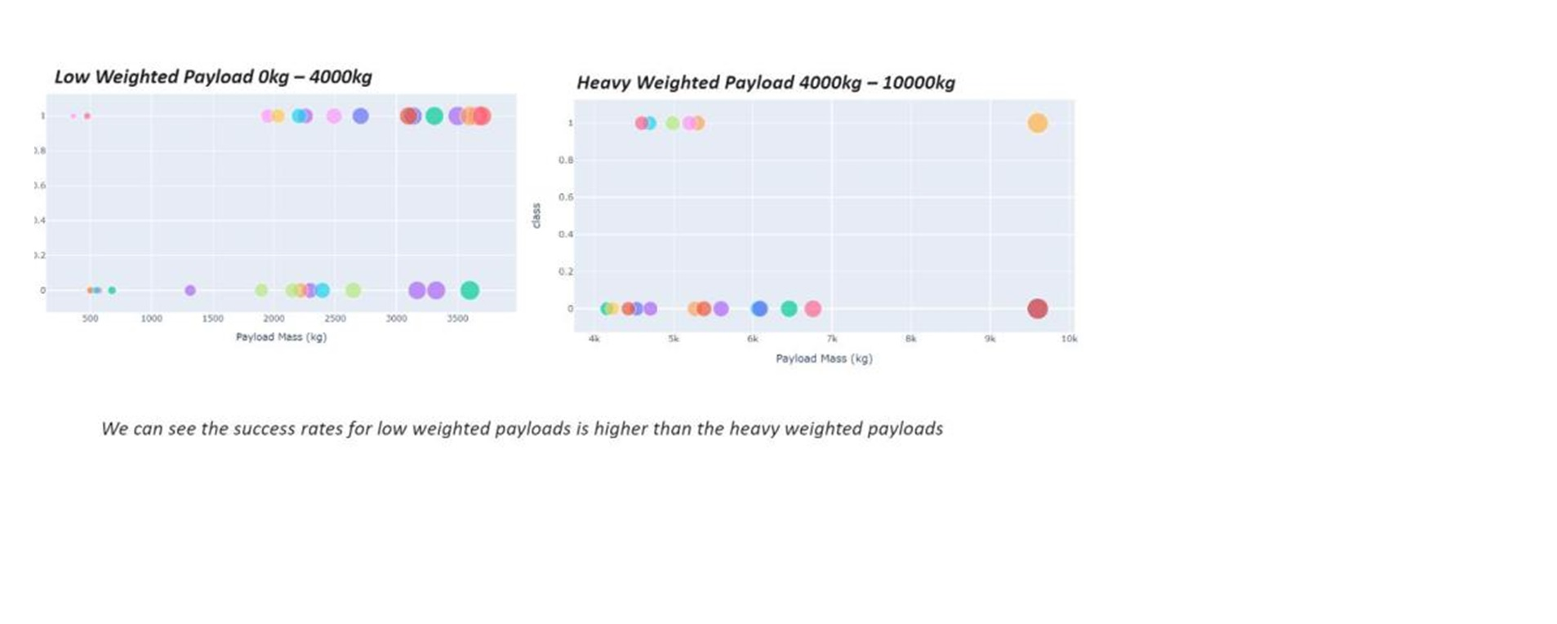
Scatter plot of Payload vs Launch Outcome for all sites, with different payload selected in the range slider
The plot shows that the low weighted payloads had higher success rate than the heavy weighted payloads

Slide 42

Section 5

Slide 43
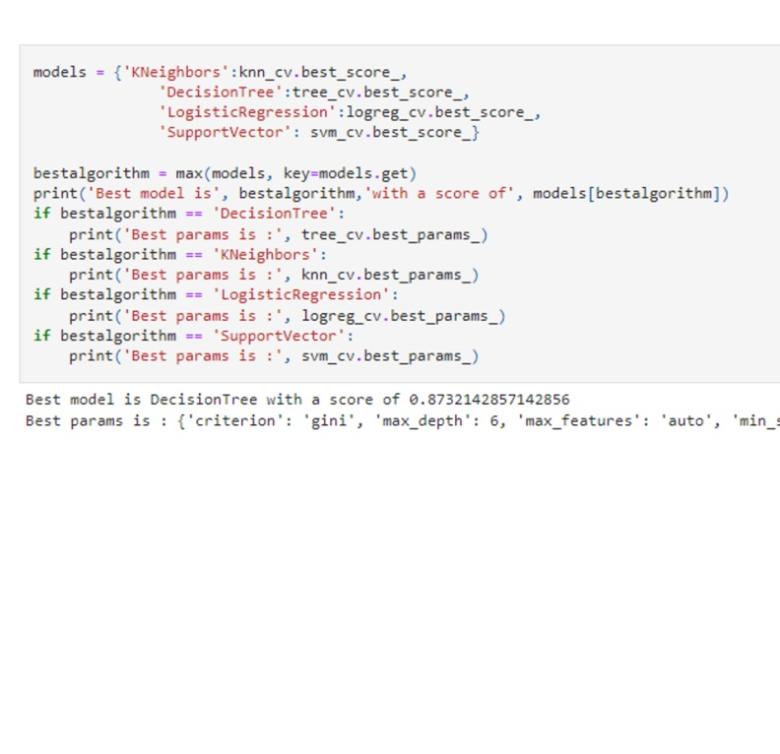
Classification Accuracy
DecisionTree was found to be the best model with a score of 0.873

Slide 44
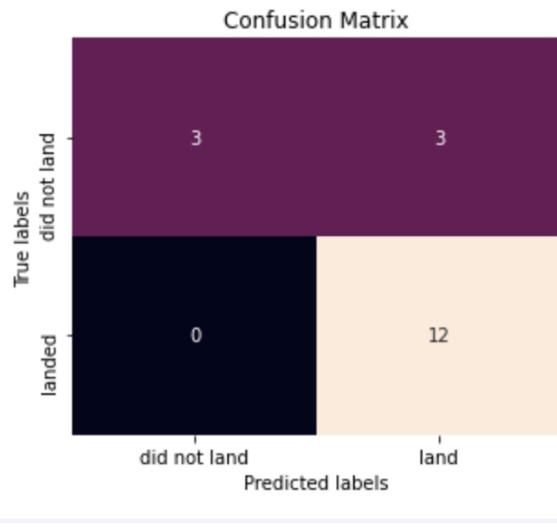
Confusion Matrix
Except, the false positives .i.e., unsuccessful landing marked as successful, . all the 4 classification model can distinguish between the different classes and had similar results.

Slide 45
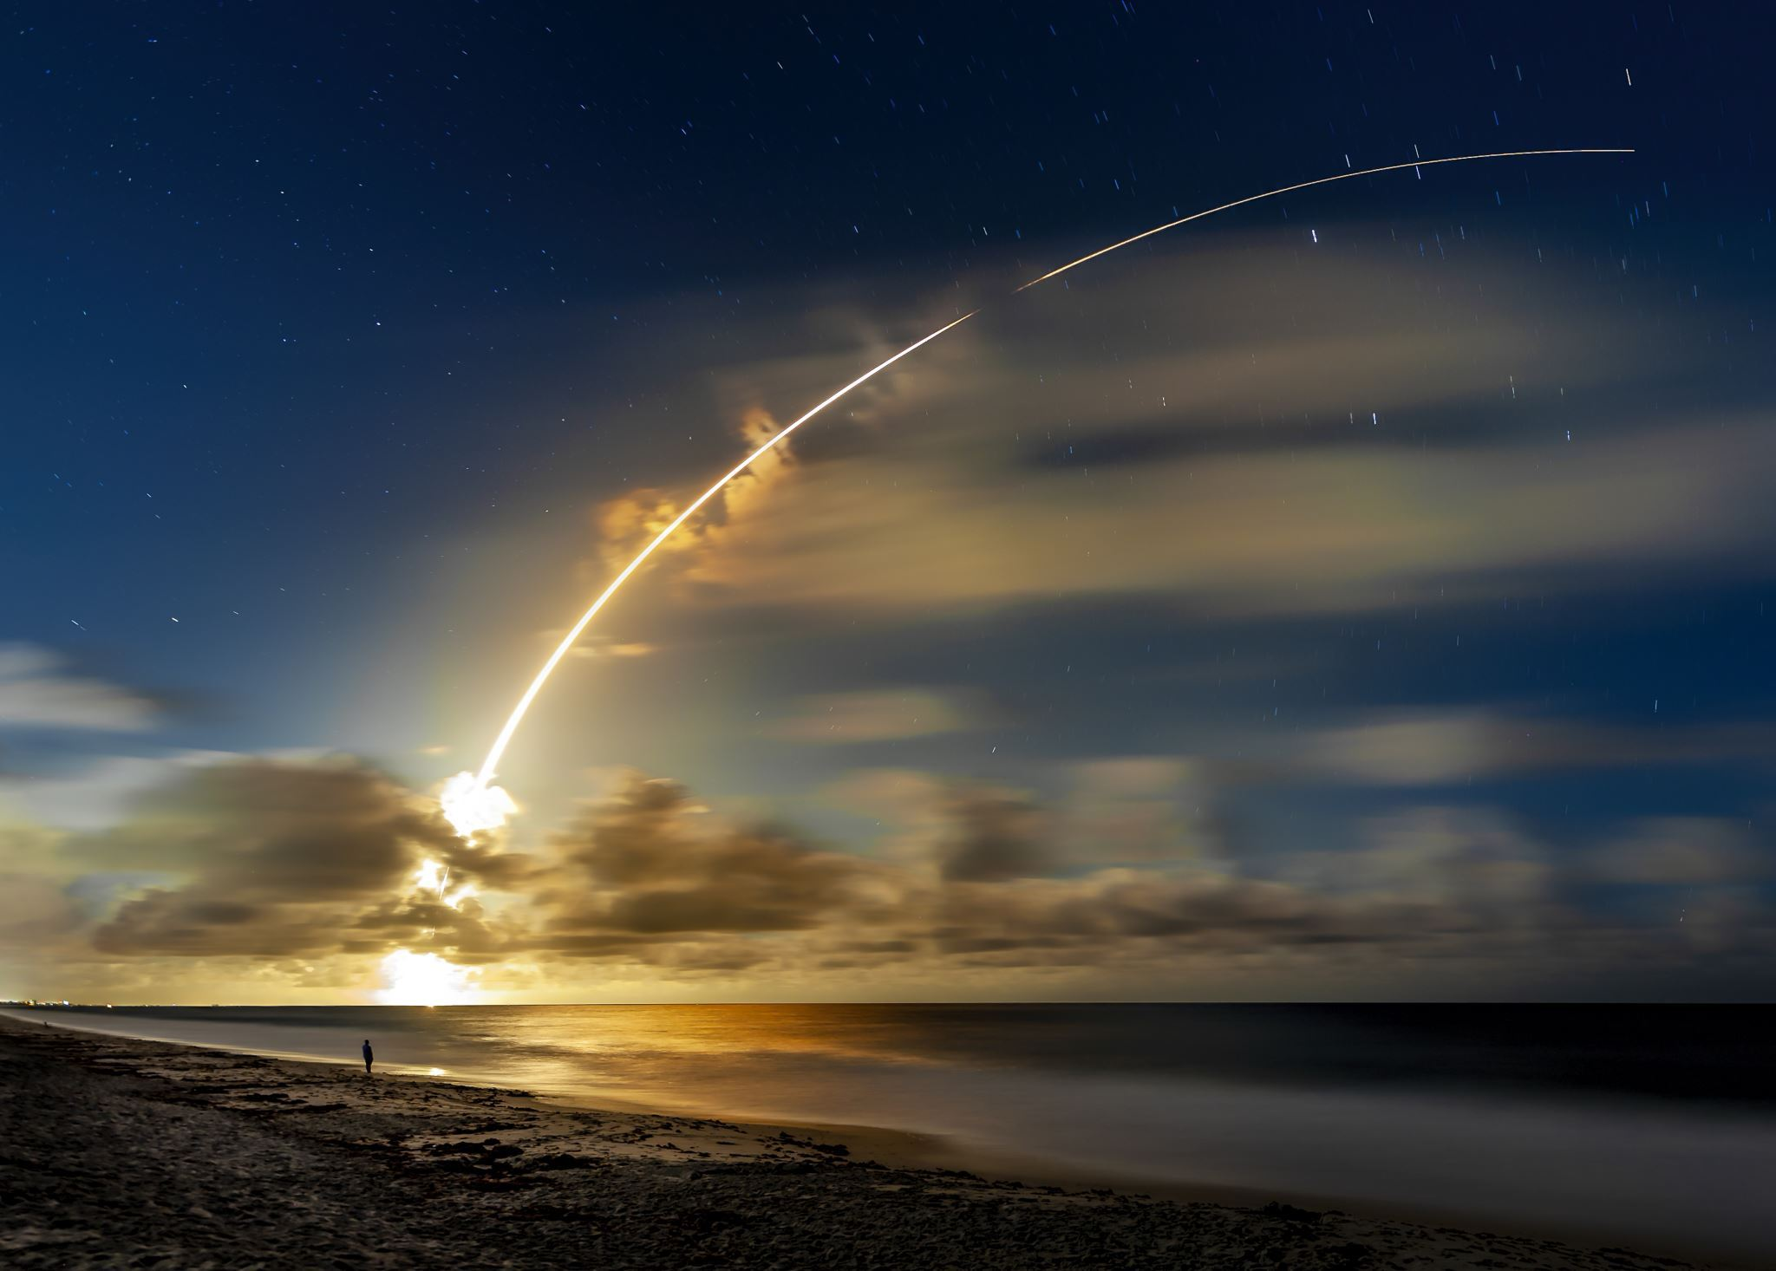
Conclusions
The result of data analysis showed that, the degree of successful landing outcomes differed by launch sites
The most successful launches site was KSC LC-39A
The most success rates were obtained at Orbit ES-L1, GEO, HEO, SSO, and VLEO
A positive r/ship was observed between flight number and success rate., where the former increase the later too.
Looking at the distribution of the success rate by year, success was increased from 2013 on wards.

Slide 46


